Slide 1
Monitoring with Prometheus
Weaveworks – https://weave.works – @weaveworks

Slide 2

Unless specified, these slides are © Weaveworks 2019.
They are made available under a Creative Common License.
Attribution-NonCommercial-ShareAlike 4.0 International (CC BY-NC-SA 4.0)
You can attribute in the following way:
“Created by Weaveworks / Derived from material created by Weaveworks.
Original available at https://tinyurl.com/monitoring-with-prometheus”

Slide 3
Monitoring with Prometheus

Slide 4
Monitoring

Slide 5
Monitoring vs Observability
Notes:
Monitoring is for operating software/systems Instrumentation is for writing software Observability is for understanding systems
Observability is the superset. It encompasses any question you may want to ask if your systems -- including business and support q's.
Monitoring is about specific, actionable alerts. Instrumentation is your software reporting upstream about its behavior and internal state.
If you think every question you may ask of your system should be turned into an alert, you haven't worked on distributed systems
Prediction: we are going to move towards far fewer paging alerts as systems get more and more complex. Latency, errors, request rate
Maybe a few end-to-end checks that traverse critical business functions. That's it. Nothing else should wake you up middle of the night. Because we will bake in more resilience, and systems won't fail in those same few predictable ways. They'll fail in new and exciting ways! None of which you could have predicted and written an alert for when you were developing the software. Few of which will ever repeat. ortunately, you will have instrumented it so well that you can diagnose any new problem in a few clicks. Hell, your support team can too.
MONITORING
“Monitoring” refers to repeatedly checking a system and its outputs to make sure they are within known-good ranges. It’s the operational version of integration tests. Monitoring is heavily biased toward outages and problems, and all monitoring checks *must* be actionable. Conventions associated with monitoring: operations, black boxes, metrics, dashboards, alerting, rapid diagnostic of recurring failure conditions, thresholds, using clusters of symptoms plus intuition/mental models to infer root causes, runbooks, etc Monitoring: mostly metrics, controls cost and volume by sacrificing fidelity vertically w aggregation at write time + limiting context Monitoring best practice: “don’t watch graphs all day! The system should notify you whenever there is a problem.”
OBSERVABILITY
Observability, otoh, is about being able to understand the inner workings of your software and systems by asking questions and observing the answers on the outside. Any question — no particular bias toward actionable alerts or problems.
the in-depth instrumentation that lets you slice and dice and sift in real time to answer strange new questions and explore unknown-unknowns. Conventions associated with o11y: software development, APM, instrumentation, the health of the event matters more than the system, high cardinality, tracing, slower/open-ended exploratory investigation, iterative debugging, everything ties back to build ids and LoC Observability: mostly structured data, controls cost and volume by sacrificing horizontally w dynamic sampling. Aggregates at read time. O11y best practice: “only 3-4 paging alerts. Check graphs regularly to ensure you see the changes you expected to see, and look for unexpected ones/outliers”

Slide 6
Known Unknown
Metrics, alerts, actionable, dashboards, canned queries
Monitoring vs Observability
Notes:
Monitoring is for operating software/systems Instrumentation is for writing software Observability is for understanding systems
Observability is the superset. It encompasses any question you may want to ask if your systems -- including business and support q's.
Monitoring is about specific, actionable alerts. Instrumentation is your software reporting upstream about its behavior and internal state.
If you think every question you may ask of your system should be turned into an alert, you haven't worked on distributed systems
Prediction: we are going to move towards far fewer paging alerts as systems get more and more complex. Latency, errors, request rate
Maybe a few end-to-end checks that traverse critical business functions. That's it. Nothing else should wake you up middle of the night. Because we will bake in more resilience, and systems won't fail in those same few predictable ways. They'll fail in new and exciting ways! None of which you could have predicted and written an alert for when you were developing the software. Few of which will ever repeat. ortunately, you will have instrumented it so well that you can diagnose any new problem in a few clicks. Hell, your support team can too.
MONITORING
“Monitoring” refers to repeatedly checking a system and its outputs to make sure they are within known-good ranges. It’s the operational version of integration tests. Monitoring is heavily biased toward outages and problems, and all monitoring checks *must* be actionable. Conventions associated with monitoring: operations, black boxes, metrics, dashboards, alerting, rapid diagnostic of recurring failure conditions, thresholds, using clusters of symptoms plus intuition/mental models to infer root causes, runbooks, etc Monitoring: mostly metrics, controls cost and volume by sacrificing fidelity vertically w aggregation at write time + limiting context Monitoring best practice: “don’t watch graphs all day! The system should notify you whenever there is a problem.”
OBSERVABILITY
Observability, otoh, is about being able to understand the inner workings of your software and systems by asking questions and observing the answers on the outside. Any question — no particular bias toward actionable alerts or problems.
the in-depth instrumentation that lets you slice and dice and sift in real time to answer strange new questions and explore unknown-unknowns. Conventions associated with o11y: software development, APM, instrumentation, the health of the event matters more than the system, high cardinality, tracing, slower/open-ended exploratory investigation, iterative debugging, everything ties back to build ids and LoC Observability: mostly structured data, controls cost and volume by sacrificing horizontally w dynamic sampling. Aggregates at read time. O11y best practice: “only 3-4 paging alerts. Check graphs regularly to ensure you see the changes you expected to see, and look for unexpected ones/outliers”

Slide 7
Known Unknown
Metrics, alerts, actionable, dashboards, canned queries
Monitoring vs Observability
Unknown Unknown
Inspect, observe, explore, trace, custom queries
Notes:
Monitoring is for operating software/systems Instrumentation is for writing software Observability is for understanding systems
Observability is the superset. It encompasses any question you may want to ask if your systems -- including business and support q's.
Monitoring is about specific, actionable alerts. Instrumentation is your software reporting upstream about its behavior and internal state.
If you think every question you may ask of your system should be turned into an alert, you haven't worked on distributed systems
Prediction: we are going to move towards far fewer paging alerts as systems get more and more complex. Latency, errors, request rate
Maybe a few end-to-end checks that traverse critical business functions. That's it. Nothing else should wake you up middle of the night. Because we will bake in more resilience, and systems won't fail in those same few predictable ways. They'll fail in new and exciting ways! None of which you could have predicted and written an alert for when you were developing the software. Few of which will ever repeat. ortunately, you will have instrumented it so well that you can diagnose any new problem in a few clicks. Hell, your support team can too.
MONITORING
“Monitoring” refers to repeatedly checking a system and its outputs to make sure they are within known-good ranges. It’s the operational version of integration tests. Monitoring is heavily biased toward outages and problems, and all monitoring checks *must* be actionable. Conventions associated with monitoring: operations, black boxes, metrics, dashboards, alerting, rapid diagnostic of recurring failure conditions, thresholds, using clusters of symptoms plus intuition/mental models to infer root causes, runbooks, etc Monitoring: mostly metrics, controls cost and volume by sacrificing fidelity vertically w aggregation at write time + limiting context Monitoring best practice: “don’t watch graphs all day! The system should notify you whenever there is a problem.”
OBSERVABILITY
Observability, otoh, is about being able to understand the inner workings of your software and systems by asking questions and observing the answers on the outside. Any question — no particular bias toward actionable alerts or problems.
the in-depth instrumentation that lets you slice and dice and sift in real time to answer strange new questions and explore unknown-unknowns. Conventions associated with o11y: software development, APM, instrumentation, the health of the event matters more than the system, high cardinality, tracing, slower/open-ended exploratory investigation, iterative debugging, everything ties back to build ids and LoC Observability: mostly structured data, controls cost and volume by sacrificing horizontally w dynamic sampling. Aggregates at read time. O11y best practice: “only 3-4 paging alerts. Check graphs regularly to ensure you see the changes you expected to see, and look for unexpected ones/outliers”

Slide 8
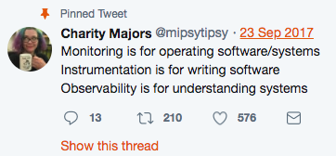

Monitoring
&
Observability
Follow @mipsytipsy for more
Notes:
Monitoring is for operating software/systems Instrumentation is for writing software Observability is for understanding systems
Observability is the superset. It encompasses any question you may want to ask if your systems -- including business and support q's.
Monitoring is about specific, actionable alerts. Instrumentation is your software reporting upstream about its behavior and internal state.
If you think every question you may ask of your system should be turned into an alert, you haven't worked on distributed systems
Prediction: we are going to move towards far fewer paging alerts as systems get more and more complex. Latency, errors, request rate
Maybe a few end-to-end checks that traverse critical business functions. That's it. Nothing else should wake you up middle of the night. Because we will bake in more resilience, and systems won't fail in those same few predictable ways. They'll fail in new and exciting ways! None of which you could have predicted and written an alert for when you were developing the software. Few of which will ever repeat. ortunately, you will have instrumented it so well that you can diagnose any new problem in a few clicks. Hell, your support team can too.
MONITORING
“Monitoring” refers to repeatedly checking a system and its outputs to make sure they are within known-good ranges. It’s the operational version of integration tests. Monitoring is heavily biased toward outages and problems, and all monitoring checks *must* be actionable. Conventions associated with monitoring: operations, black boxes, metrics, dashboards, alerting, rapid diagnostic of recurring failure conditions, thresholds, using clusters of symptoms plus intuition/mental models to infer root causes, runbooks, etc Monitoring: mostly metrics, controls cost and volume by sacrificing fidelity vertically w aggregation at write time + limiting context Monitoring best practice: “don’t watch graphs all day! The system should notify you whenever there is a problem.”
OBSERVABILITY
Observability, otoh, is about being able to understand the inner workings of your software and systems by asking questions and observing the answers on the outside. Any question — no particular bias toward actionable alerts or problems.
the in-depth instrumentation that lets you slice and dice and sift in real time to answer strange new questions and explore unknown-unknowns. Conventions associated with o11y: software development, APM, instrumentation, the health of the event matters more than the system, high cardinality, tracing, slower/open-ended exploratory investigation, iterative debugging, everything ties back to build ids and LoC Observability: mostly structured data, controls cost and volume by sacrificing horizontally w dynamic sampling. Aggregates at read time. O11y best practice: “only 3-4 paging alerts. Check graphs regularly to ensure you see the changes you expected to see, and look for unexpected ones/outliers”

Slide 9
The
Monitoring
Ladder
7
Proactivity
6
Automation
5
Learning
4
Analysis
3
Aggregation
2
Collection
1
Availability
0
Ignorance

Slide 10
The
Monitoring
Ladder
7
Proactivity
6
Automation
5
Learning
4
Analysis
You don’t know
what’s going on
3
Aggregation
2
Collection
1
Availability
0
Ignorance

Slide 11
The
Monitoring
Ladder
7
Proactivity
6
Automation
5
Learning
4
Analysis
You know whether your systems are available.
You may have alerts
3
Aggregation
2
Collection
Availability
1
Availability
1
Ignorance
0
Ignorance
0

Slide 12
The
Monitoring
Ladder
7
Proactivity
6
Automation
5
Learning
4
Analysis
You collect logs.
Forensics is possible.
3
Aggregation
Collection
2
Collection
2
Availability
Alerts
1
Availability
1
Ignorance
0
Ignorance
0

Slide 13
The
Monitoring
Ladder
7
Proactivity
6
Automation
5
Learning
You aggregate and persist data in a central place.
Correlation is possible.
4
Analysis
Aggregation
3
Aggregation
3
Logs Forensics
Collection
2
Collection
2
Availability
Alerts
1
Availability
1
Ignorance
0
Ignorance
0

Slide 14
The
Monitoring
Ladder
7
Proactivity
6
Automation
5
Learning
Analysis
4
Analysis
4
You actually analyse
the aggregated and
correlated data.
Use it to fix issues.
Aggregation
Persistence
3
Aggregation
3
Logs Forensics
Collection
2
Collection
2
Availability
Alerts
1
Availability
1
Ignorance
0
Ignorance
0

Slide 15
The
Monitoring
Ladder
7
Proactivity
6
Automation
Learning
5
Learning
5
Analysis
4
Analysis
Root cause analysis.
Strengthening fixes.
Antigfragile.
Still responsive.
4
Aggregation
Persistence
3
Aggregation
3
Logs Forensics
Collection
2
Collection
2
Availability
Alerts
1
Availability
1
Ignorance
0
Ignorance
0

Slide 16
The
Monitoring
Ladder
7
Proactivity
Automation
6
Automation
6
Learning
5
Learning
Antifragile
5
Analysis
4
Analysis
4
Automated remediations.
Incident report creation.
No customer impact.
Aggregation
Persistence
3
Aggregation
3
Logs Forensics
Collection
2
Collection
2
Availability
Alerts
1
Availability
1
Ignorance
0
Ignorance
0

Slide 17
The
Monitoring
Ladder
7
Proactivity
Automation
6
Automation
0-impact
6
Learning
5
Learning
Antifragile
5
Analysis
4
Analysis
4
Aggregation
Persistence
3
Aggregation
3
Logs Forensics
Collection
2
Collection
2
Availability
Alerts
1
Availability
1
Ignorance
0
Ignorance
0

Slide 18
The
Monitoring
Ladder
Proactivity
7
Proactivity
7
Automation
6
Automation
0-impact
6
Learning
5
Learning
Antifragile
5
Analysis
4
Analysis
4
Active strengthening
by attacking
production systems.
“Chaos Engineering”
Aggregation
Persistence
3
Aggregation
3
Logs Forensics
Collection
2
Collection
2
Availability
Alerts
1
Availability
1
Ignorance
0
Ignorance
0

Slide 19
The
Monitoring
Ladder
Proactivity
7
Proactivity
Chaos Engineering
7
Automation
6
Automation
0-impact
6
Learning
5
Learning
Antifragile
5
Analysis
4
Analysis
4
Aggregation
Persistence
3
Aggregation
3
Monitoring is a broad topic
Logs Forensics
Collection
2
Collection
2
Availability
Alerts
1
Availability
1
Ignorance
0
Ignorance
0

Slide 20
The
Monitoring
Ladder
Proactivity
7
Proactivity
Chaos Engineering
7
Automation
6
Automation
0-impact
6
Learning
5
Learning
Antifragile
5
Analysis
4
Analysis
4
Aggregation
Boundaries aren’t so clear cut.
Persistence
3
Aggregation
3
Logs Forensics
Collection
2
Collection
2
Availability
Alerts
1
Availability
1
Ignorance
0
Ignorance
0

Slide 21
Maslow’s Pyramid of Metrics (?)

Slide 22
Maslow’s Pyramid of Metrics (?)
CPU, Memory, Threads, …
Domain - Computers
Platform

Slide 23
Maslow’s Pyramid of Metrics (?)
Requests, HTTP Errors,
Queue stats.
Domain - Protocols
Middleware
Platform

Slide 24
Maslow’s Pyramid of Metrics (?)
Users, widgets,
teams, products.
Domain - Application
App
Middleware
Platform

Slide 25
Maslow’s Pyramid of Metrics (?)
Biz
Money, subscriptions, growth.
Domain - Business
App
Middleware
Platform

Slide 26

Pull based
Whitebox
Historic

Slide 27
Instrumenting your application

Slide 28
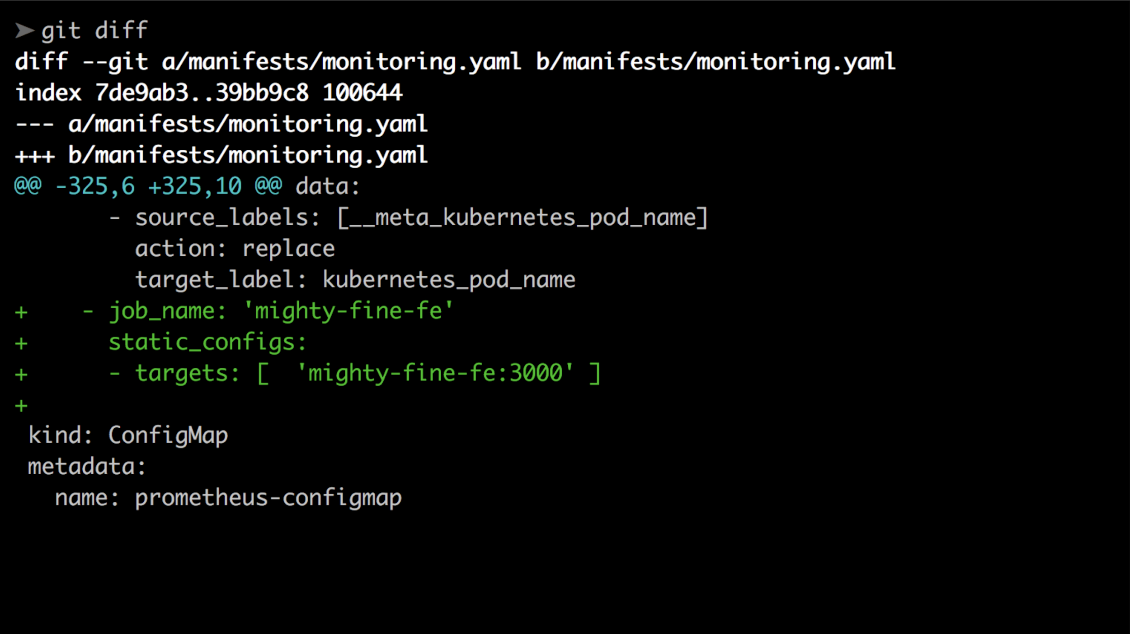
1. Tell Prometheus to scrape the service endpoint

Slide 29
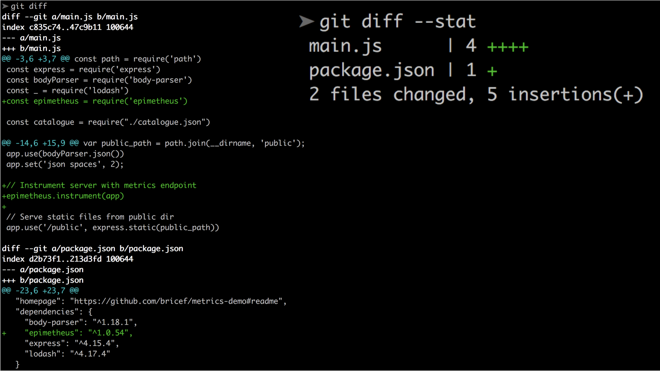
2. Install the default exporter for basic metrics

Slide 30
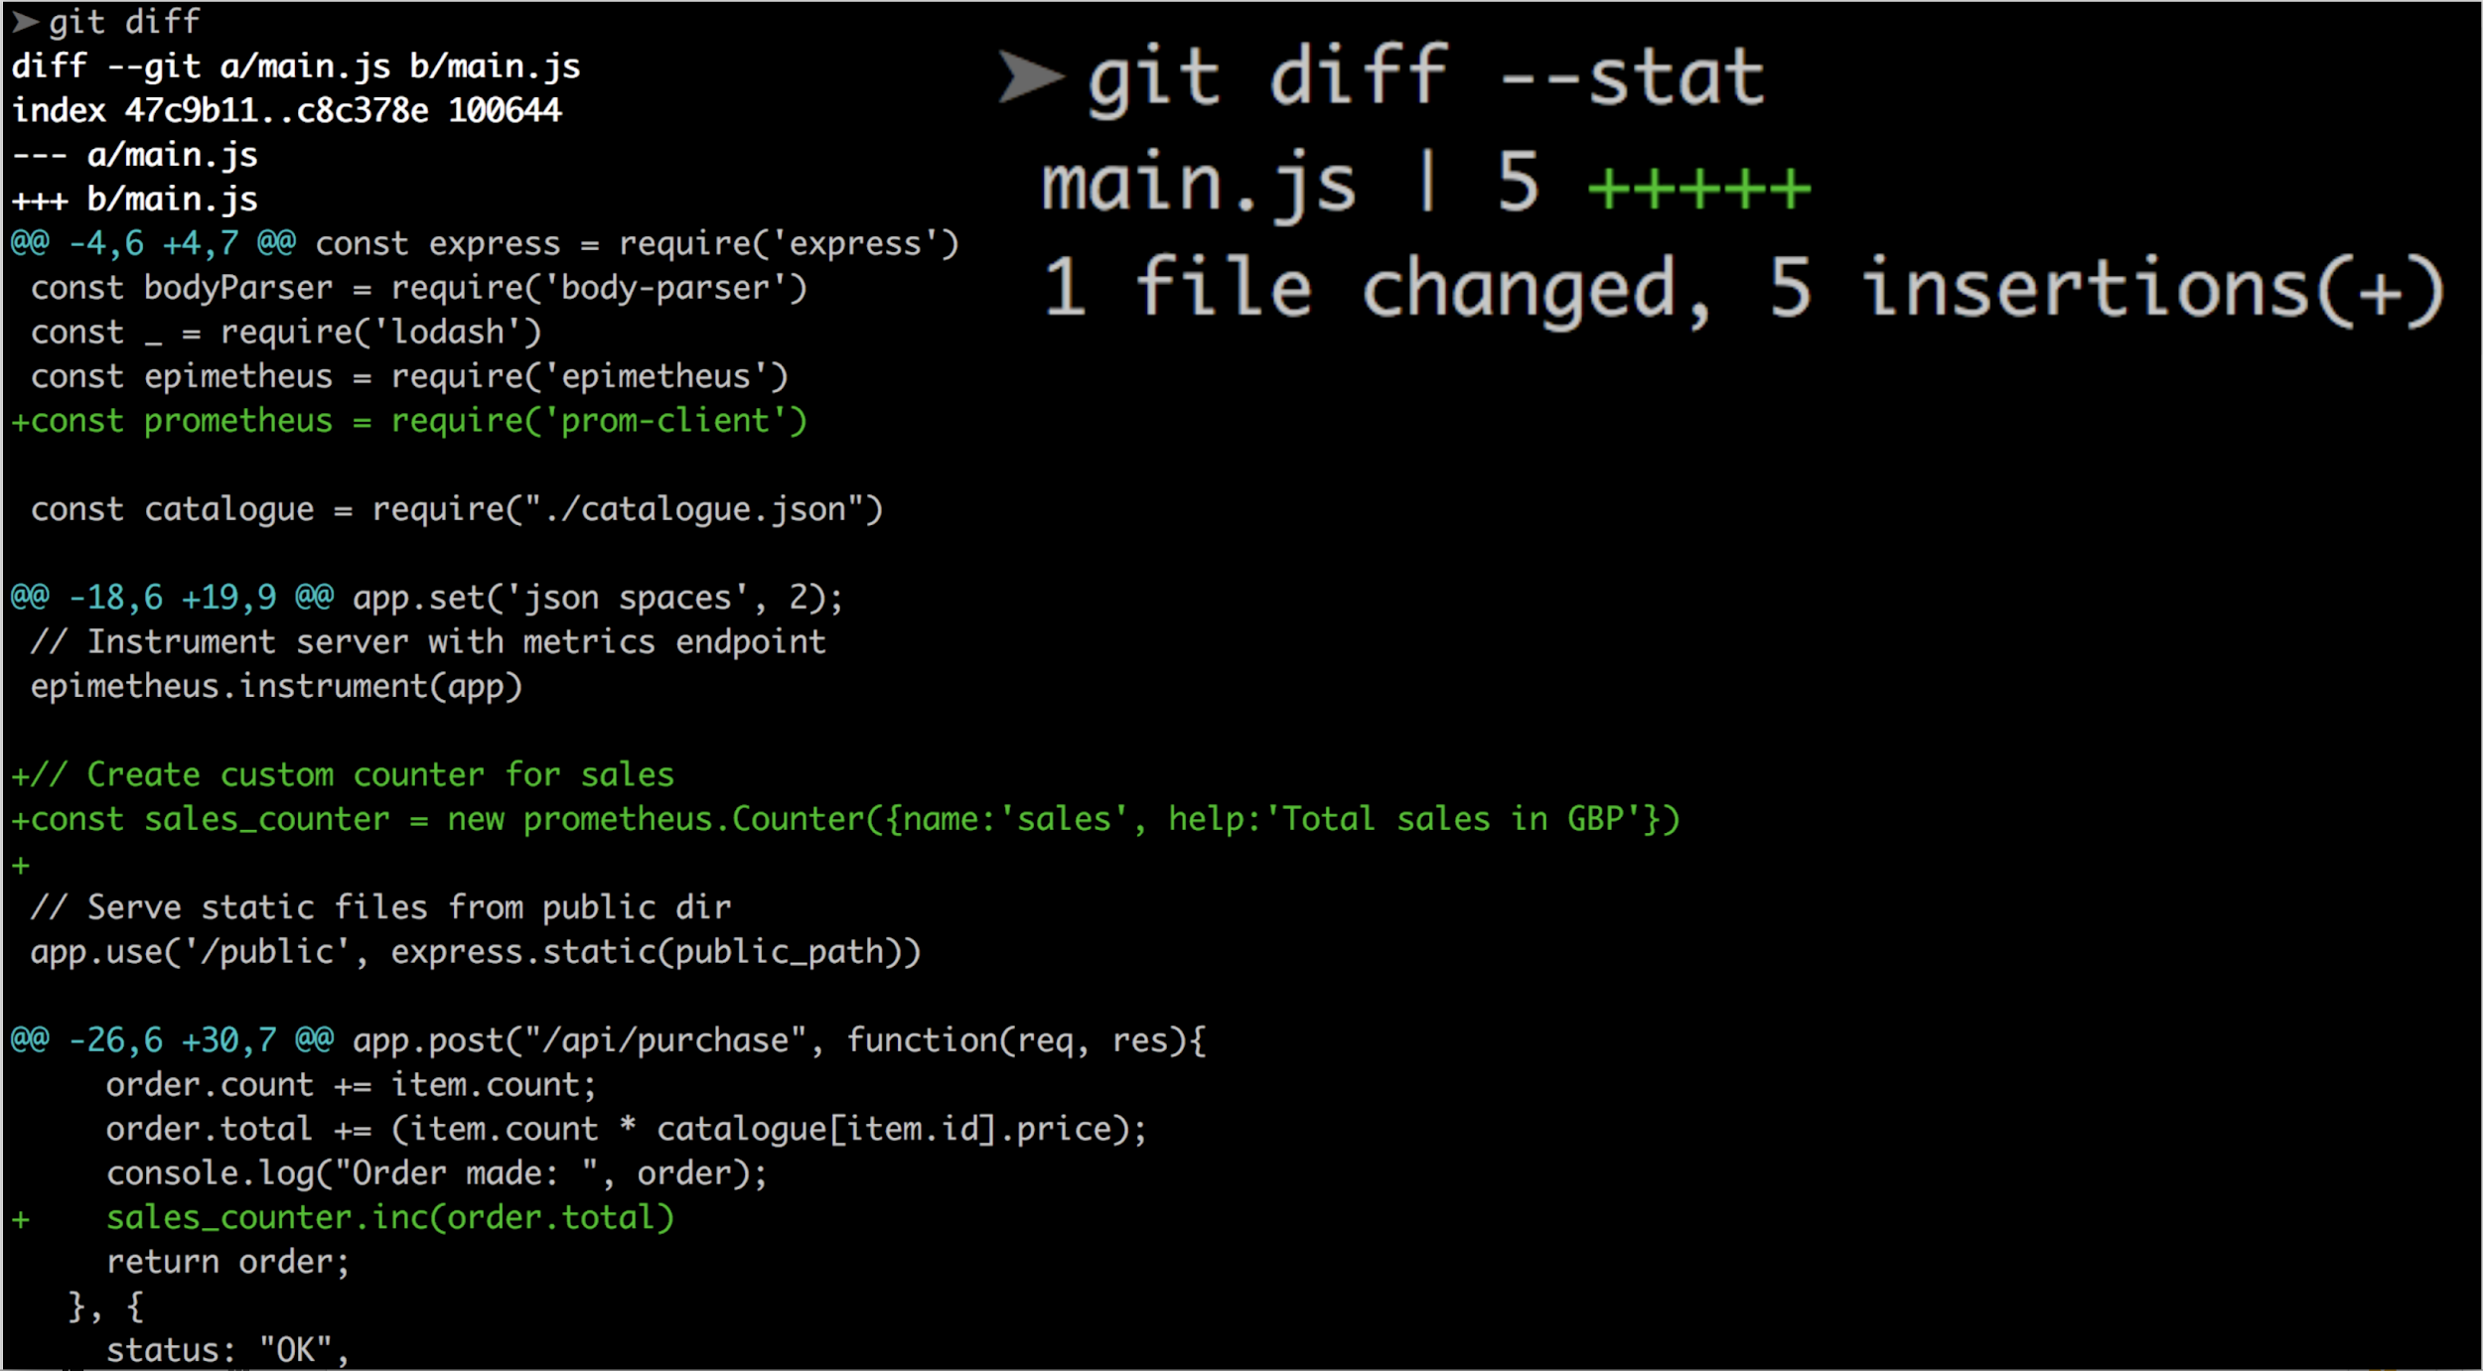
3. Add custom metrics

Slide 31
Types of metrics

Slide 32
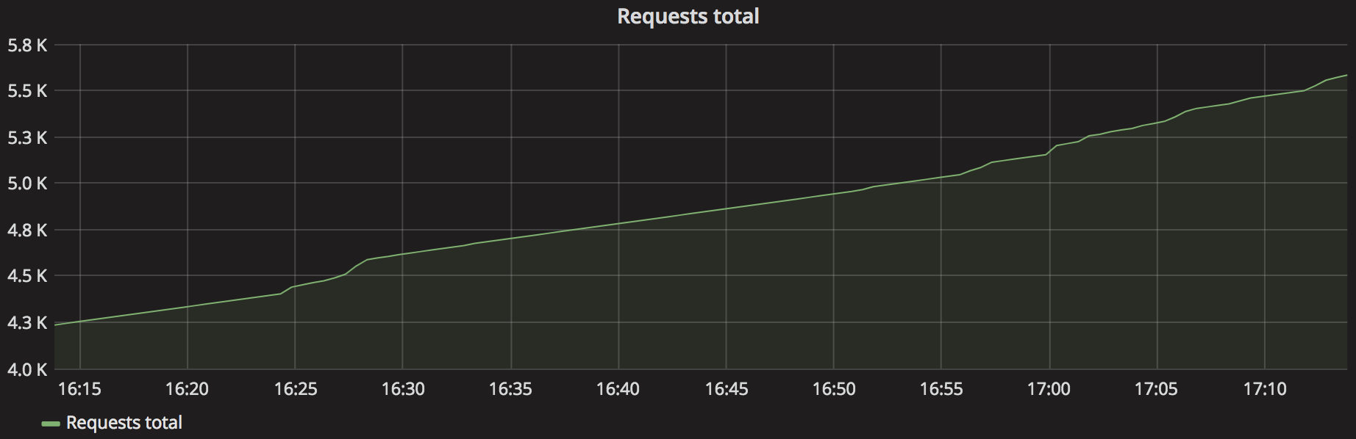
Counters
The only way is up

Slide 33
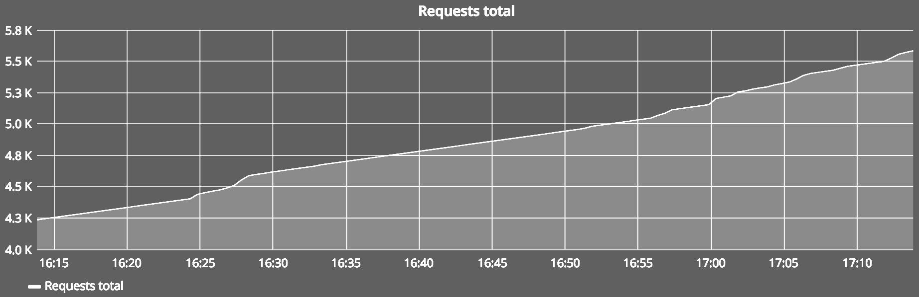
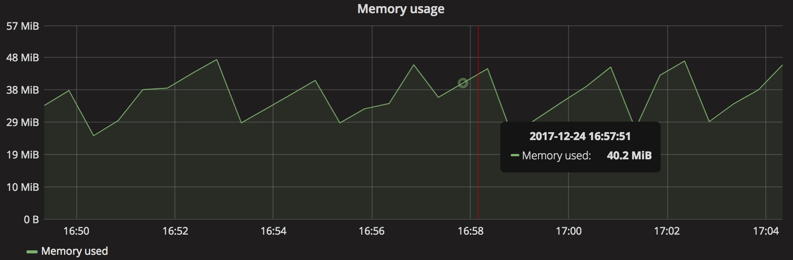
Counters
Gauges
The only way is up
What goes up must go down

Slide 34
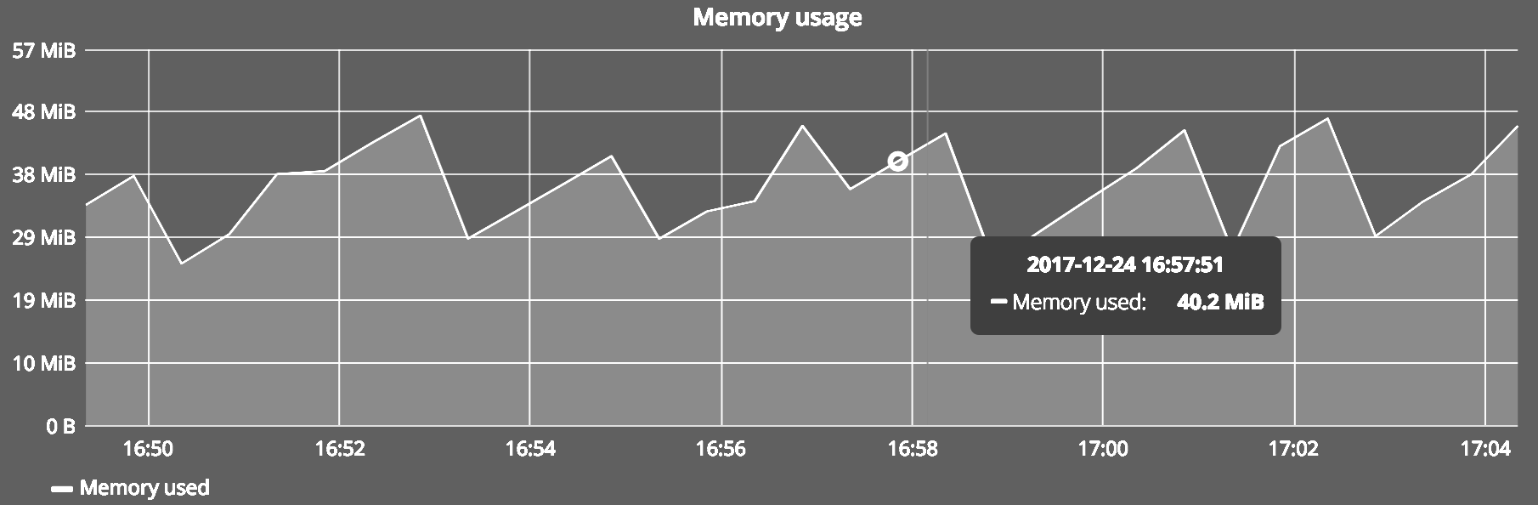
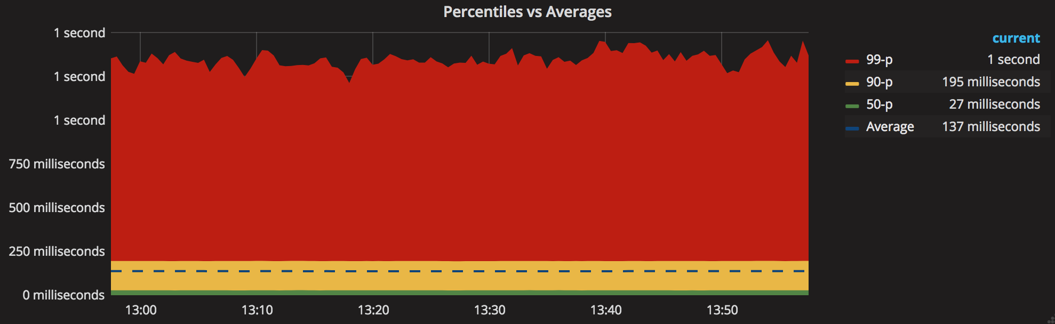
Counters
Gauges
The only way is up
Histograms
Distributions of values

Slide 35
Metrics that matter

Slide 36
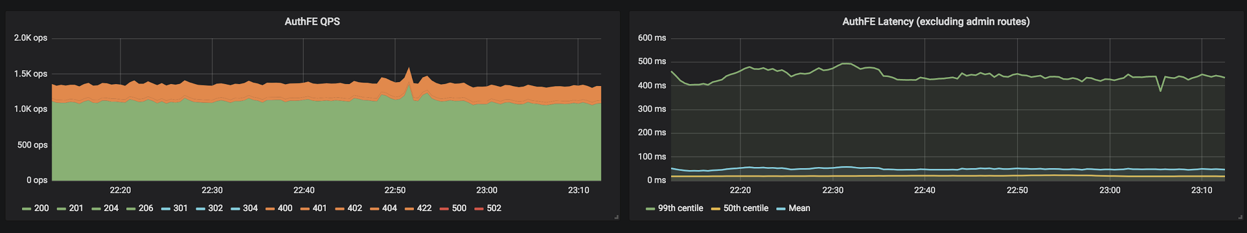
R.E.D. Metrics
Requests Errors Delays
See https://tinyurl.com/red-metrics
Compare http://apdex.org/
Compare https://tinyurl.com/four-golden-signals

Slide 37
Worked PromQL Example

Slide 38
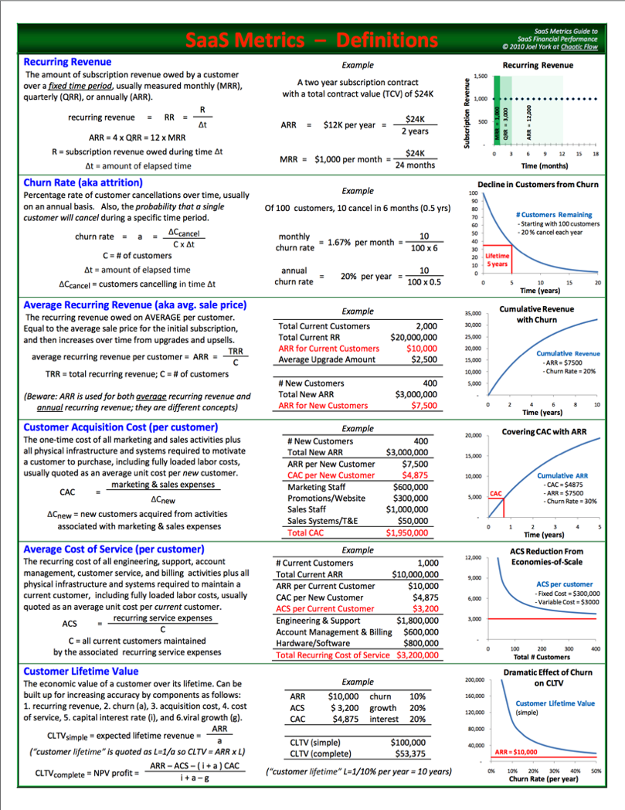
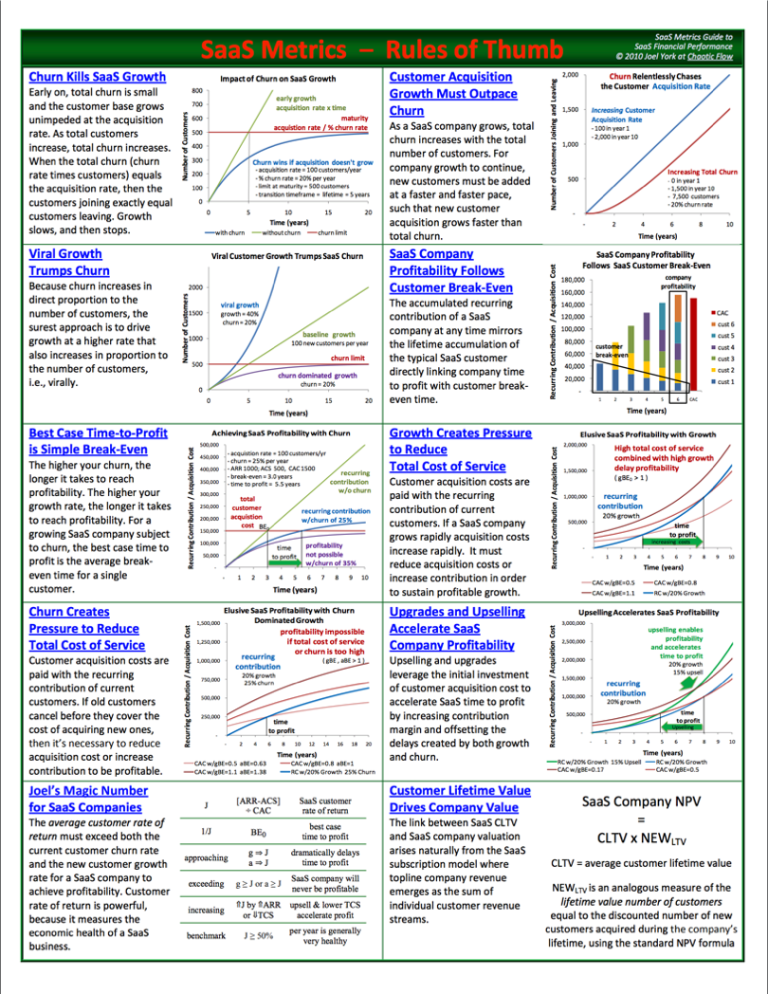
Joel York’s SaaS Metrics
http://chaotic-flow.com
http://chaotic-flow.com/media/saas-metrics-guide-to-saas-financial-performance.pdf

Slide 39
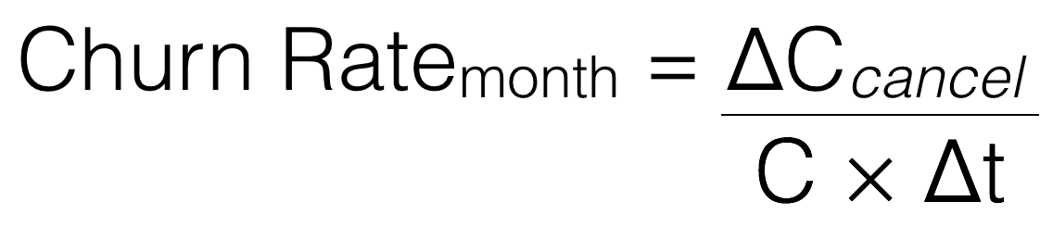

Slide 40
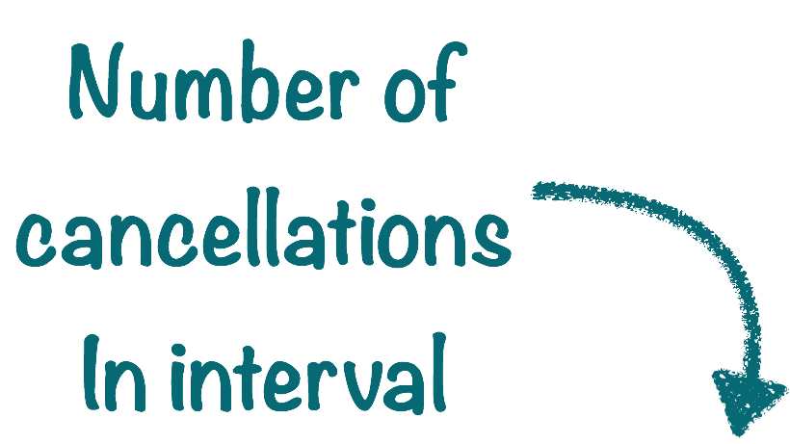

Slide 41
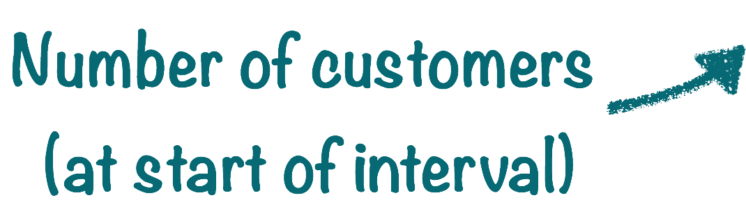

Slide 42


Slide 43
We’ll need
subscribe_count
unsubscribe_count
(Both counters)

Slide 44
ΔC_{cancel}= rate(unsubscribe_count[1m])

Slide 45
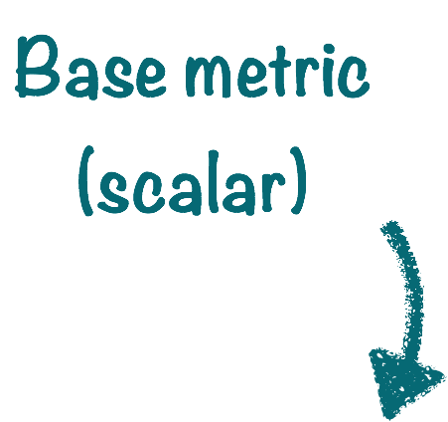
ΔC_{cancel}= rate(unsubscribe_count[1m])

Slide 46
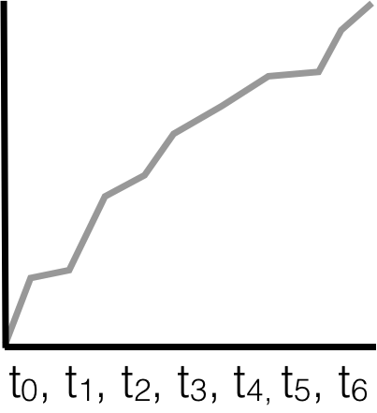
ΔC_{cancel}= rate(unsubscribe_count[1m])

Slide 47
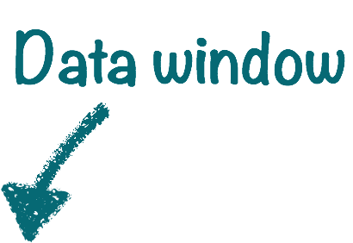
ΔC_{cancel}= rate(unsubscribe_count[1m])

Slide 48
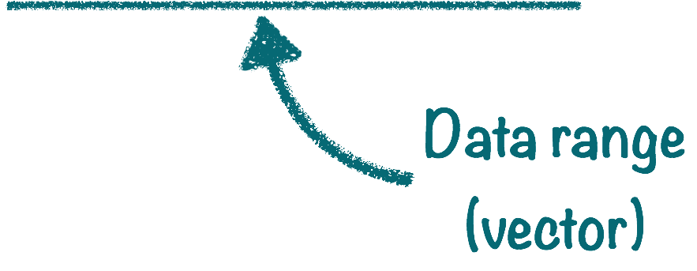
ΔC_{cancel}= rate(unsubscribe_count[1m])

Slide 49
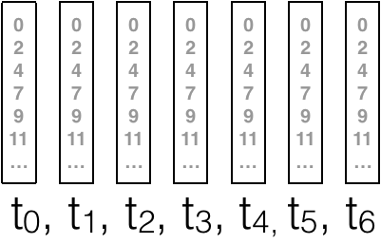
ΔC_{cancel}= rate(unsubscribe_count[1m])

Slide 50
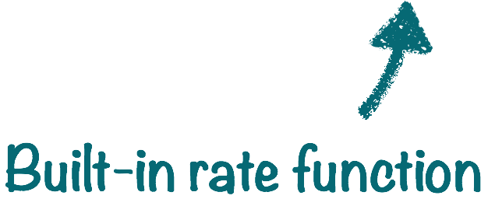
ΔC_{cancel}= rate(unsubscribe_count[1m])

Slide 51

C = (subscribe_count offset 1m) -
(unsubscribe_count offset 1m)

Slide 52
ChurnRate_{month} =
rate(subscribe_count[1m]) /
((subscribe_count offset 1m)
- (unsubscribe_count offset 1m))

Slide 53

ChurnRate_{month} =
rate(subscribe_count[1m]) /
((subscribe_count offset 1m)
- (unsubscribe_count offset 1m))

Slide 54
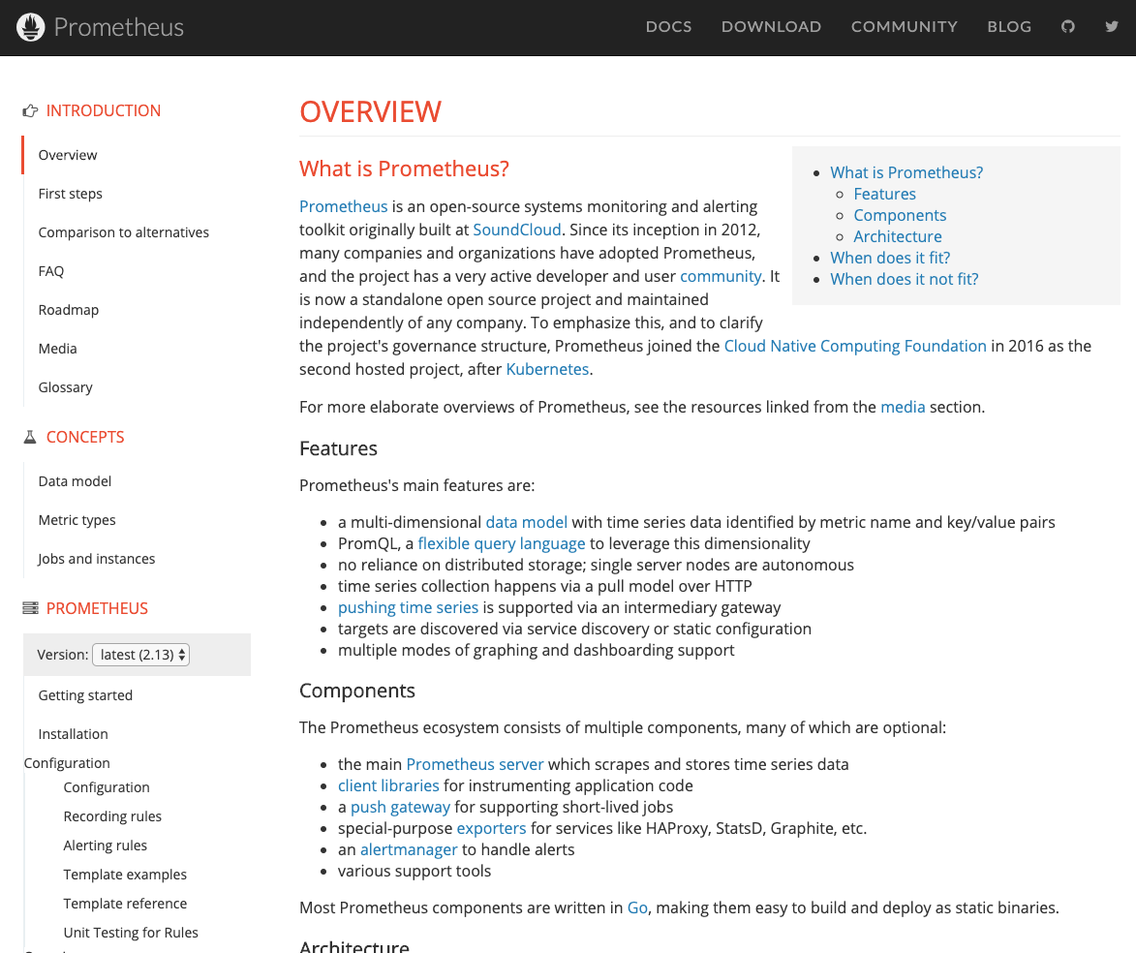
https://prometheus.io/docs/introduction/overview/

Slide 55
Recap: Monitoring with Prometheus
There are different kind of metrics
A good way to think of metrics is which domain they’re in
It’s trivial to instrument your applications
Prometheus can be used for both metrics (monitoring) and ad-hoc querying (observability)
Simple instrumentation can yield deep insights
PromQL deals with scalar and vector series
PromQL has gauges, histograms and counters
PromQL has many useful functions available

